Slide 1


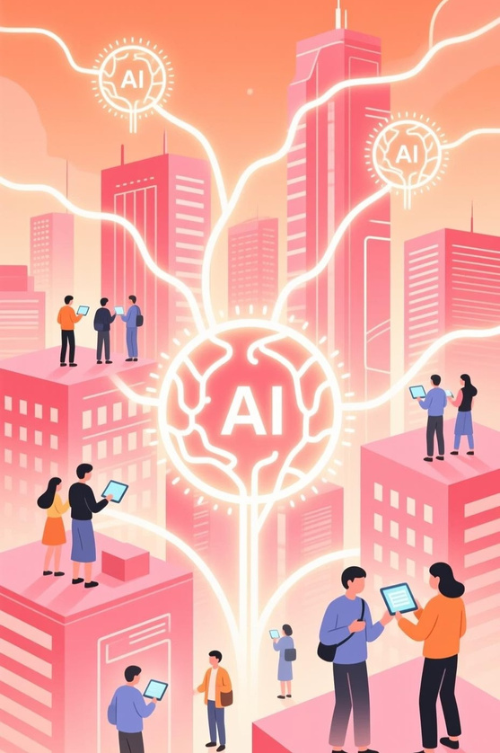
Decoding AI: Technologies, Applications, and Your Future

Slide 2

What is Artificial Intelligence? A Quick Overview
ArtificialIntelligence (AI)isa rapidlyadvancing fieldof computer sciencededicated tocreatingintelligentmachinesthatcanperform tasks
that typically require human intelligence. This involves enabling machines to learn, reason, solve problems, perceive, and understand language.
Mimicking Cognition
Automating Tasks
Data-Driven Insights
AI systems aim to replicate human cognitive functions like learning and problem-solving.
From routine automation to complex decision-making, AI enhances operational efficiency.
AI excels at processing vast datasets to uncover patterns and make predictions.

Slide 3

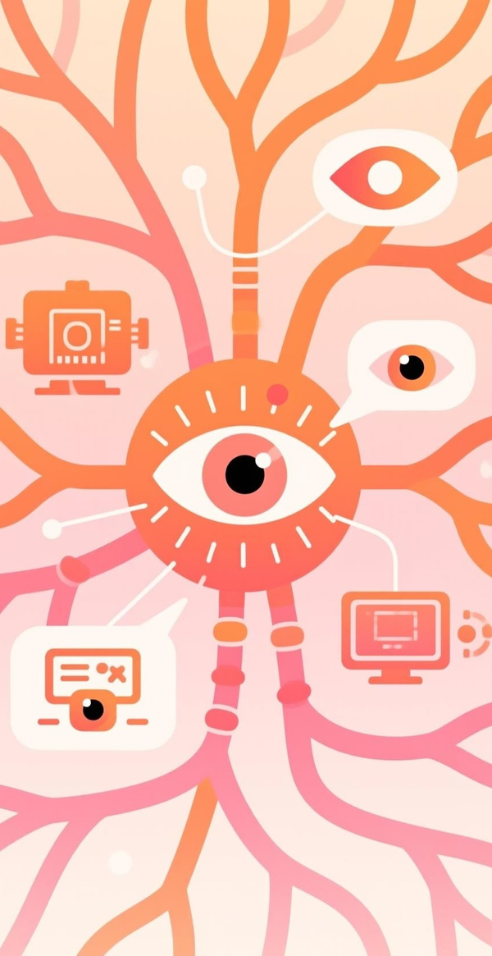


Key AI Technologies: The Pillars of Intelligent Systems
Machine Learning
Enablessystemstolearn from data without explicit programming,
improving performance over time through experience.
Deep Learning
Asubset ofmachinelearning using neural networks with many layers to
analyze various factors, often inspired by the human brain.
Natural Language Processing (NLP)
Allowscomputerstounderstand, interpret,andgenerate human language,
bridging the gap between humans and machines.
Computer Vision
Empowersmachines to"see" and interpret visual information from the
world, enabling tasks like object recognition and image analysis.

Slide 4

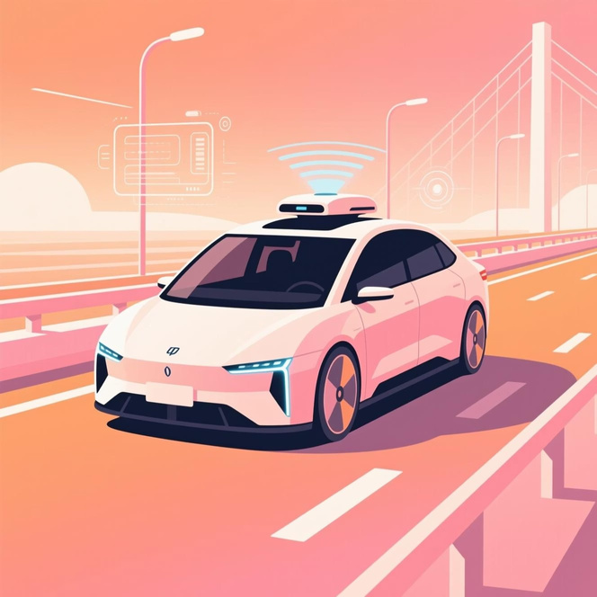
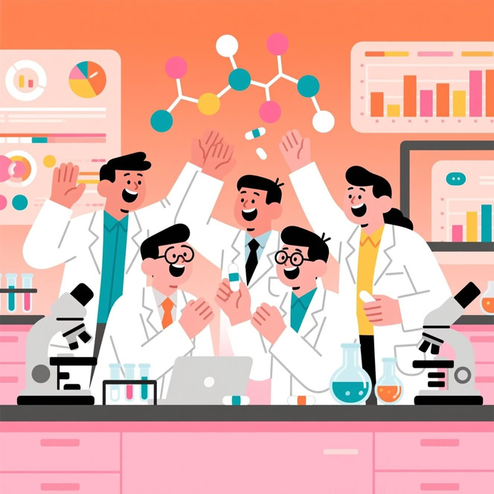
AI in Action: Global Use Cases
AIistransformingindustriesworldwide,fromrevolutionizingtransportationtoaccelerating scientific discovery.
Autonomous Vehicles
Drug Discovery
AI-powered self-driving cars use computer vision and deep learning to navigate, perceive surroundings, and make real-time decisions, enhancing safety and efficiency.
AI accelerates the identification of new drug candidates, predicts molecular interactions, and optimizes experimental designs, significantly reducing time and cost in pharmaceutical research.

Slide 5





AI's Impact in India: Transforming Industries
India is leveraging AI to address unique challenges and unlock new opportunities across key sectors.
Agriculture Enhancement
Healthcare Innovation
Smart City Development
AI tools help farmers predict crop yields, monitor soil health, and optimize irrigation, leading to improved productivity and reduced waste.
AI assists in early disease detection, personalized treatment plans, and efficient management of patient data, improving access and quality of care.
AI contributes to intelligent traffic management, waste optimization, and public safety systems, making urban living more sustainable.

Slide 6

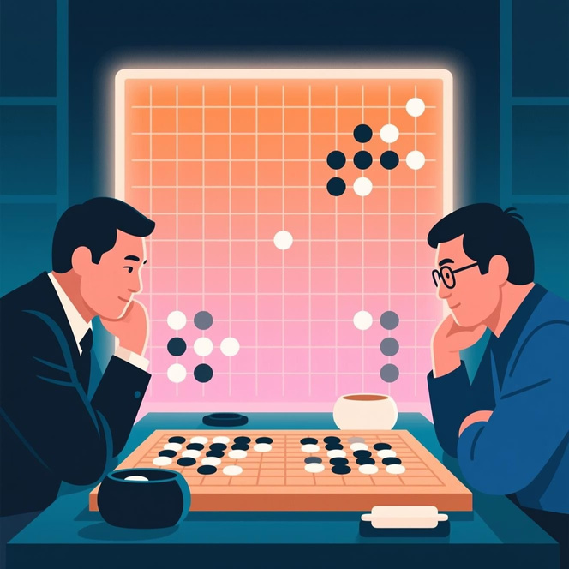
Real-World Case Study 1: Google's DeepMind and AlphaGo
DeepMind's AlphaGo project showcased AI's ability to master complex strategic games, achieving superhuman performance.
Mastering Go
AlphaGo, an AI program developed by Google DeepMind, became the first computer program to defeat a professional human Go player in 2016. Go is an ancient strategy game known for its immense complexity.
Reinforcement Learning
This groundbreaking achievement was possible due to AlphaGo's advanced use of reinforcement learning and deep neural networks, enabling it to learn from vast amounts of game data and self-play.
Impact
AlphaGo's success demonstrated AI's potential for sophisticated problem-solving beyond human intuition, paving the way for applications in diverse fields like scientific research and complex system optimization.

Slide 7

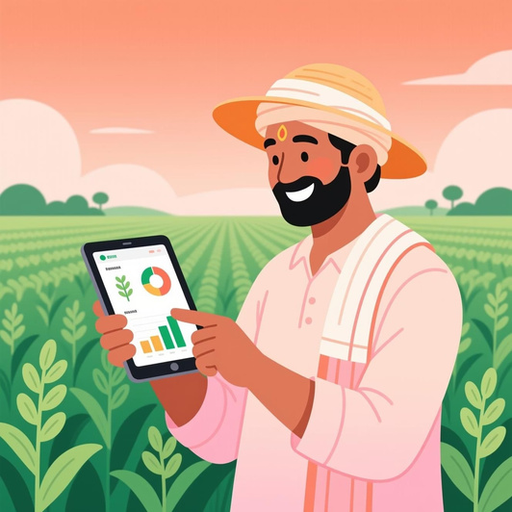
Real-World Case Study 2: NITI Aayog's AI in Agriculture Initiatives
NITI Aayog, India's policy think tank, is championing AI adoption to revolutionize the agricultural sector and empower farmers.
Crop Yield Prediction
AI models analyze satellite imagery, weather data, and soil conditions to provide accurate forecasts of crop yields, helping farmers make informed decisions and manage risks.
Pest and Disease Detection
Using computer vision, AI systems can identify crop diseases and pest infestations early, allowing for timely intervention and minimizing crop loss.
Market Price Forecasting
AI algorithms predict market prices for agricultural produce, enabling farmers to sell their crops at optimal times and secure better returns.
Enhancing Farmer Livelihoods
These initiatives aim to boost agricultural productivity, reduce waste, and improve the economic well-being of millions of Indian farmers.

Slide 8
Career Opportunities in AI: Roles, Skills, and Growth
The demand for AI professionals is soaring, opening up exciting career paths across various specializations.
Data Scientist
ML Engineer
AI Researcher
Robotics Engineer
Analyzes large datasets to extract insights and build predictive models.
Designs, builds, and maintains machine learning systems and algorithms.
Pioneers new AI algorithms, theories, and applications.
Develops and programs robots for automation and intelligent tasks.

Slide 9


The Future of AI: Trends, Challenges, and Ethical Considerations
AI's future holds immense promise, but also significant challenges that require careful navigation and ethical reflection.
Generative / Edge
Explainable AI
Energy & Bias
Fairness &
Accounta
bility
Ethical
Conside
rations
Trends in AI
Challenges of AI

